Slide 1
Azure Basics
Who is your tenant?

Slide 2
Organisation
Business entity – Emu Airlines
Usually defined by a domain (or several)
Holds subscriptions
Organisation
Subscription
Subscription
Subscription
Notes:
https://docs.microsoft.com/en-us/office365/enterprise/subscriptions-licenses-accounts-and-tenants-for-microsoft-cloud-offerings

Slide 3
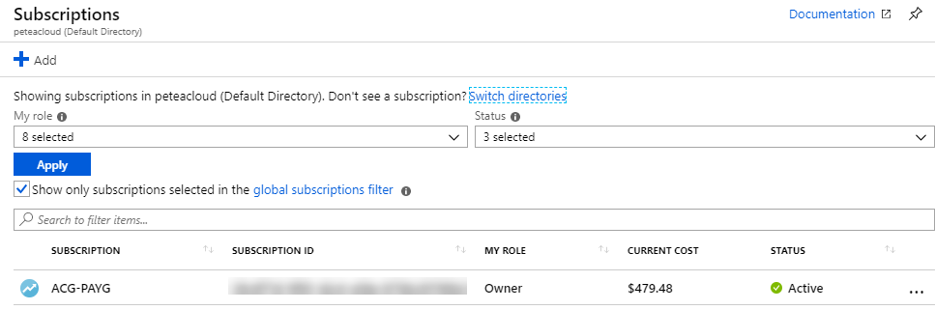
Subscription
Your agreement with Microsoft
Billing entity
Is tied to an Azure Tenant

Slide 4
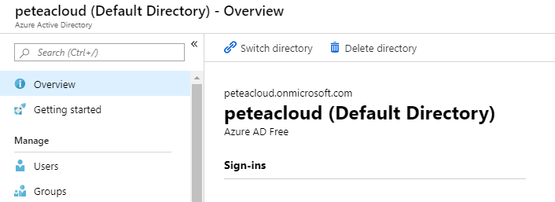
Azure Active Directory
Users live here
Identity and access management
Both for applications, resources and users
Single Sign-On (SSO) for Apps
Notes:
https://docs.microsoft.com/en-us/azure/active-directory/fundamentals/active-directory-whatis

Slide 5
Tenant
Dedicated and trusted instance of Azure AD
Created with your first Azure subscription
A user can be in multiple tenants
A subscription has one tenant
A tenant can have many subscriptions

Slide 6
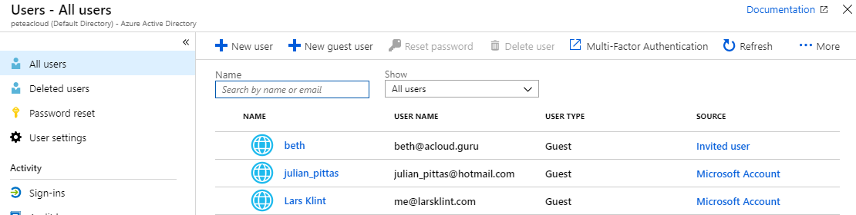
User Account
Stored in an Azure Active Directory tenant
Can have multiple roles
Service Admin
Billing Admin

Slide 7

Tenant
Tenant
Subscription
Subscription
Subscription

Slide 8
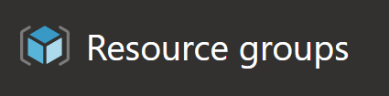
Resource Groups
Logical grouping within a subscription
Every resource must be in a resource group
Not a resource

Slide 9
ARM Templates
Automation
Uses ARM API
Declarative
Source control
Deploys resources, but not code
Tear down, Set up
Notes:
https://github.com/Azure/azure-quickstart-templates

